Slide 1

Advanced Topics in Economic Evaluation and Healthcare
Lecture #3: Decision Tree Models

Slide 2
Lecture Overview
In this lecture we will discuss.
  What a decision tree model is.
  How decision trees are representations of expected value equations.
  The Design and Style of a Decision Tree Model.
  Using Decision Trees to Represent Possible Clinical Pathways.
  Using Decision Tree Models to Compute ICERs.
  Building a Decision Tree “Backwards” from an Expected Value Equation.
By the end of this lecture, it is hoped that you will have the tools to read and build your own decision tree models based on theory.

Slide 3
What is a Decision Tree
A Decision Tree is a tool for evaluating alternatives when a single action must be made at the cost of the others.
Decision Trees are used as a way of drawing clinical pathways and evaluating alternative treatments for patients. They are mostly used investment in new drugs, health technology or programs which are patient centered.
Formally: They are Graphic Representation of a Choice over Possible Expected Values.

Slide 4
Decision Trees as a Visualization of a Choice over Expected Value
Decision trees are graphical representations of expected value equations.
Example: Suppose a doctor can treat a sick patient with two different drugs.
Drug A has a 50% chance of curing the patient with no side effects a 20% chance of curing the patient with side effects and a 30% chance of doing nothing.
Drug B has a 80% chance of curing the patient with side effects and 20% chance of doing nothing
0.5
Cured + No Side Effects
0.2
Drug A
Cured + Side Effects
0.3
Nothing
0.8
Cured + Side Effects
Drug B
0.2
Nothing

Slide 5

Decision Trees as a Visualization of a Choice over Expected Value
Decision trees are graphical representations of expected value equations.
Example:Suppose a doctor can treat a sick patient with two different drugs.
Drug A has a 50% chance of curing the patient with no side effects a 20% chance of curing the patient with side effects and a 30% chance of doing nothing.
Drug B has a 80% chance of curing the patient with side effects and 20% chance of doing nothing
0.5
Cured + No Side Effects
0.2
$$EV_{A}=0.5u\left(C_{NSE}\right)+0.2u\left(C_{SE}\right)+0.3u(Sick)$$
Drug A
Cured + Side Effects
0.3
Nothing
0.8
Cured + Side Effects
Drug B
$$EV_{B}=0.8u\left(C_{SE}\right)+0.2u(Sick)$$
0.2
Nothing

Slide 6
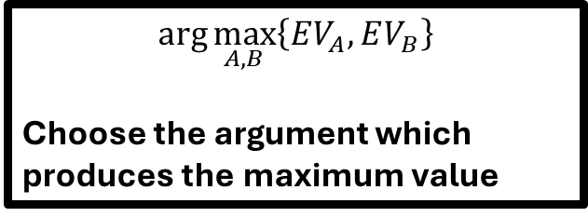
Decision Trees as a Visualization of a Choice over Expected Value
Decision trees are graphical representations of expected value equations.
Example:Suppose a doctor can treat a sick patient with two different drugs.
Drug A has a 50% chance of curing the patient with no side effects a 20% chance of curing the patient with side effects and a 30% chance of doing nothing.
Drug B has a 80% chance of curing the patient with side effects and 20% chance of doing nothing
0.5
Cured + No Side Effects
0.2
$$EV_{A}=0.5u\left(C_{NSE}\right)+0.2u\left(C_{SE}\right)+0.3u(Sick)$$
Drug A
Cured + Side Effects
$$\arg{\max_{A,B}\left\{EV_{A},EV_{B}\right\}}$$
Choose the argument which produces the maximum value
0.3
Nothing
0.8
Cured + Side Effects
Drug B
$$EV_{B}=0.8u\left(C_{SE}\right)+0.2u(Sick)$$
0.2
Nothing

Slide 7





A Style Guide for a Decision Tree
$$a_{1}$$
Pr(A)
Treatment A
Upfront Cost
1-Pr(A)
$$a_{2}$$
Pr(B)
$$b_{1}$$
Treatment B
Upfront Cost
1-Pr(B)
$$b_{2}=θ+\overline{b}$$
$$θ$$

Slide 8
A Style Guide for a Decision Tree
Decision Nodes are square and occur at the Start
of the Tree
$$a_{1}$$
Pr(A)
Treatment A
Upfront Cost
1-Pr(A)
$$a_{2}$$
Pr(B)
$$b_{1}$$
Treatment B
Upfront Cost
If there’s another decision along the tree then there is
only one branch. Otherwise the tree is not well defined
1-Pr(B)
$$b_{2}=θ+\overline{b}$$
$$θ$$

Slide 9
A Style Guide for a Decision Tree
Chance Nodes (whenever there's
uncertainty over outcomes) are Circles
$$a_{1}$$
Pr(A)
Treatment A
Upfront Cost
1-Pr(A)
$$a_{2}$$
Pr(B)
$$b_{1}$$
Treatment B
Upfront Cost
1-Pr(B)
$$b_{2}=θ+\overline{b}$$
$$θ$$

Slide 10
A Style Guide for a Decision Tree
Terminal Nodes where total costs
and benefits are realized are Triangles
$$a_{1}$$
Pr(A)
Treatment A
Upfront Cost
1-Pr(A)
$$a_{2}$$
Pr(B)
$$b_{1}$$
Treatment B
Upfront Cost
1-Pr(B)
$$b_{2}=θ+\overline{b}$$
$$θ$$

Slide 11
Some Rules for Decision Trees
In terms of a “Theory of Decision Trees” there's not a lot to know (there are no real theorems to be cognizant of which are novel).
Rule #1: Decision Nodes Should not come after chance nodes if an initial decision has already been made (Best Response Principle).
Rule #2: If a chance node occurs before the a time when an initial decision must be made and the state of the world is observable a decision is not made until this uncertainty is resolved. (Kreps’ Fundamental Rule for Decision Trees)

Slide 12
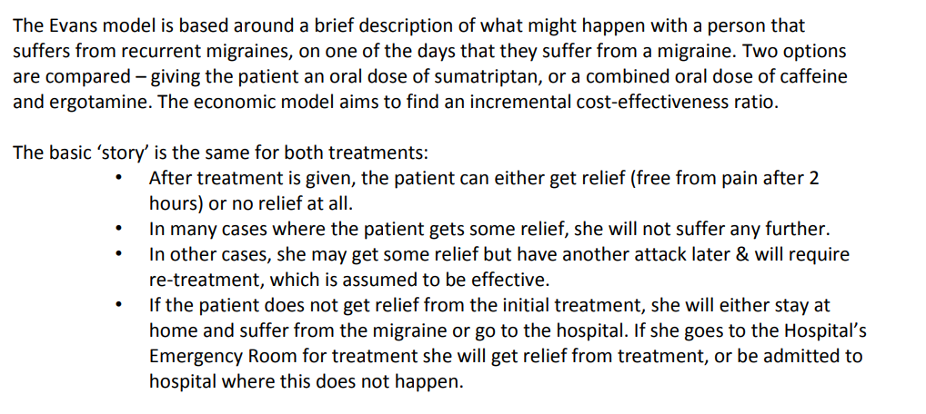
An Example of a Drawn Clinical Pathway

Slide 13
GIVE YOUR BEST ATTEMPT AT DRAWING THE TREE!
(No looking!)

Slide 14
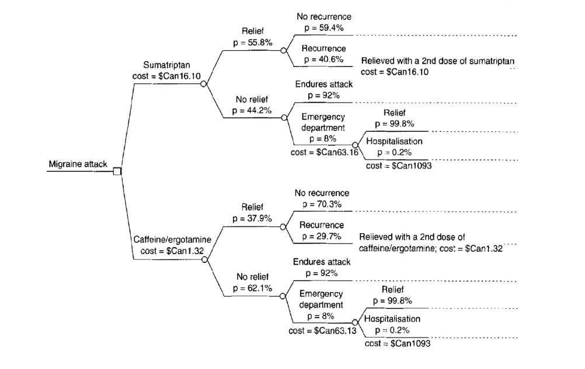
The answer:

Slide 15
Computing ICERs from Decision Trees
Example 1

Slide 16
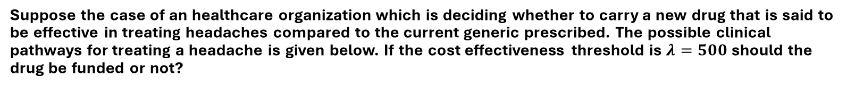
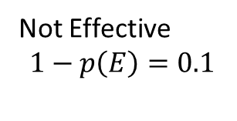
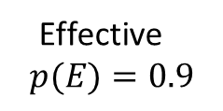
Example
Suppose the case of an healthcare organization which is deciding whether to carry a new drug that is said to be effective in treating headaches compared to the current generic prescribed. The possible clinical pathways for treating a headache is given below. If the cost effectiveness threshold is $λ=500$ should the drug be funded or not?
Effective
$$p(E)=0.9$$
QALY Gained: 0.95
New Drug
Cost: 20
QALY Gained: 0.85
Not Effective
$$1−p\left(E\right)=0.1$$
Standard
Care
Cost:10
QALY Gained: 0.9

Slide 17
How to Solve This Problem
Step 1: Calculate Expected Payoffs of Each Decision.
Step 2: Calculate ICER.
Step 3: Compare to Threshold.

Slide 18
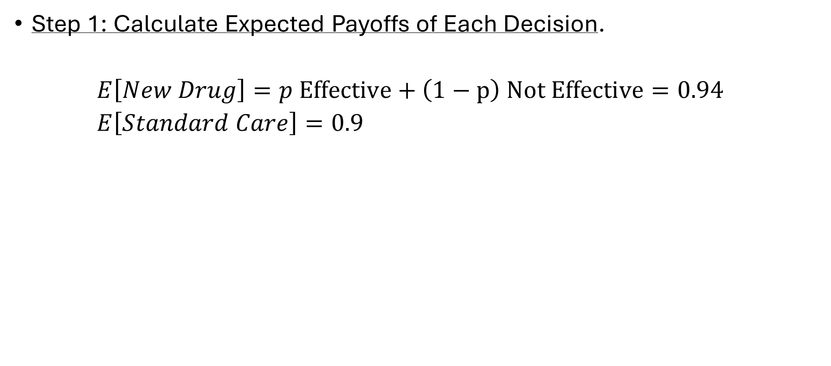
Preforming the Analysis
Step 1: Calculate Expected Payoffs of Each Decision.
$E\left[New Drug\right]=p Effective+\left(1−p\right) Not Effective=0.94$
$E\left[Standard Care\right]=0.9$

Slide 19
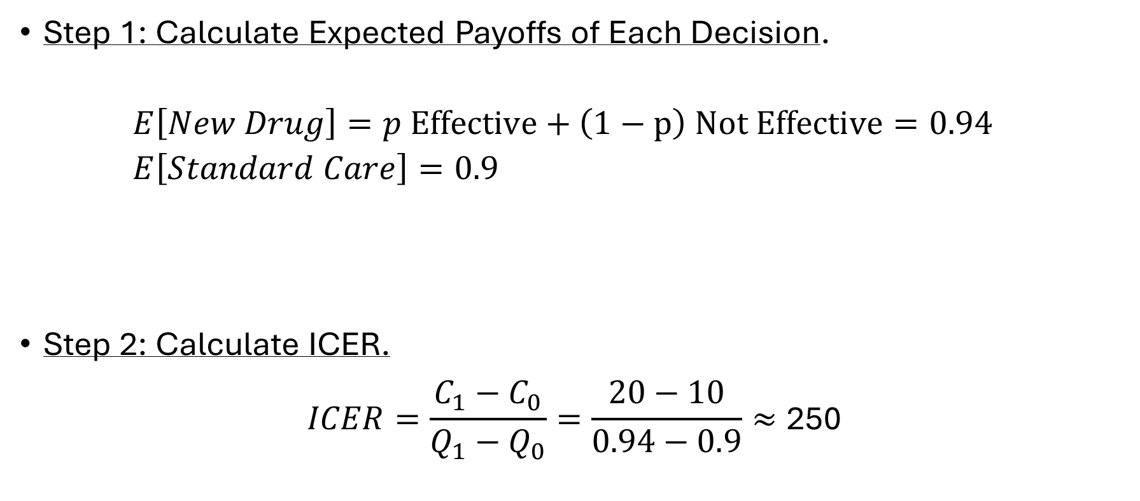
Preforming the Analysis
Step 1: Calculate Expected Payoffs of Each Decision.
$E\left[New Drug\right]=p Effective+\left(1−p\right) Not Effective=0.94$
$E\left[Standard Care\right]=0.9$
Step 2: Calculate ICER.
$ICER=\frac{C_{1}−C_{0}}{Q_{1}−Q_{0}}=\frac{20−10}{0.94−0.9}≈\text{250}$

Slide 20
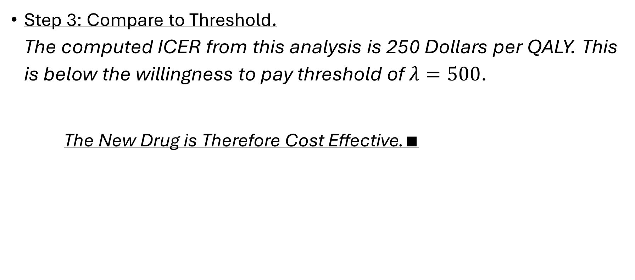
Preforming the Analysis
Step 3: Compare to Threshold.
The computed ICER from this analysis is 250 Dollars per QALY. This is below the willingness to pay threshold of $λ=500$.
The New Drug is Therefore Cost Effective.$∎$

Slide 21
Computing ICERs from Decision Trees
Example 2

Slide 22
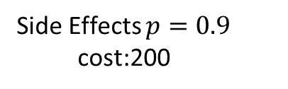
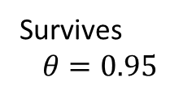
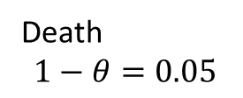
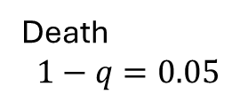
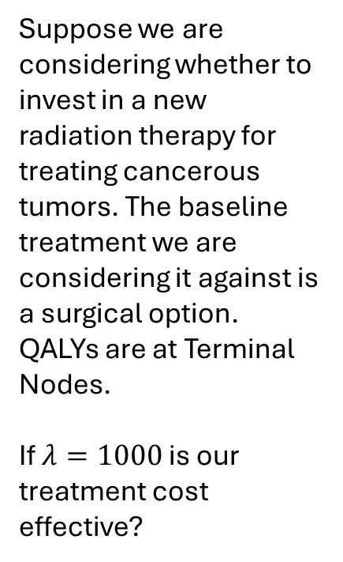
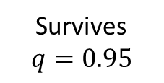
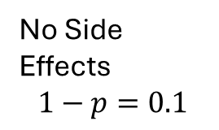
The Problem
Side Effects $p=0.9$
cost:200
Survives
$$θ=0.95$$
Suppose we are considering whether to invest in a new radiation therapy for treating cancerous tumors. The baseline treatment we are considering it against is a surgical option. QALYs are at Terminal Nodes.
If $λ=1000$ is our treatment cost effective?
0.9
New Radiation
Therapy
Death
$$1−θ=0.05$$
0
Cost:1000
No Side Effects
$$1−p=0.1$$
1
Survives
$$q=0.95$$
1
Surgical
0
Cost:1400
Death
$$1−q=0.05$$

Slide 23
How to Solve This Problem
Step 1: Calculate Expected Payoffs of Each Decision.
Step 2: Calculate ICER.
Step 3: Compare to Threshold.

Slide 24
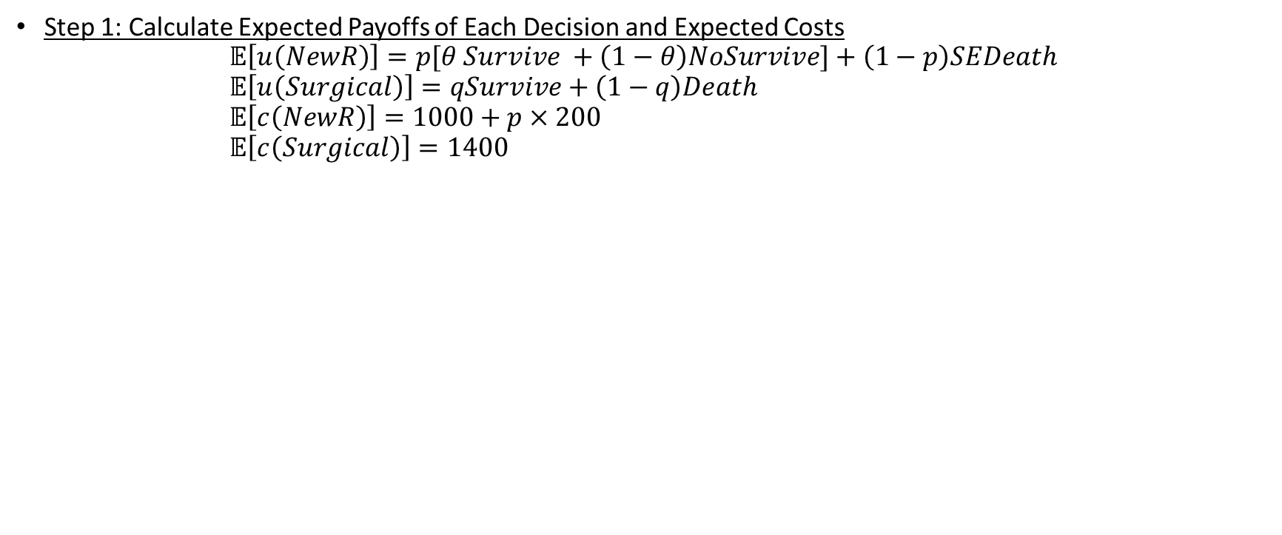
Solving the Problem
Step 1: Calculate Expected Payoffs of Each Decision and Expected Costs
$𝔼\left[u\left(NewR\right)\right]=p[θ Survive +\left(1−θ\right)NoSurvive]+\left(1−p\right)SEDeath$
$𝔼\left[u\left(Surgical\right)\right]=qSurvive+\left(1−q\right)Death$
$𝔼\left[c\left(NewR\right)\right]=1000+p×200$
$𝔼\left[c\left(Surgical\right)\right]=1400$

Slide 25
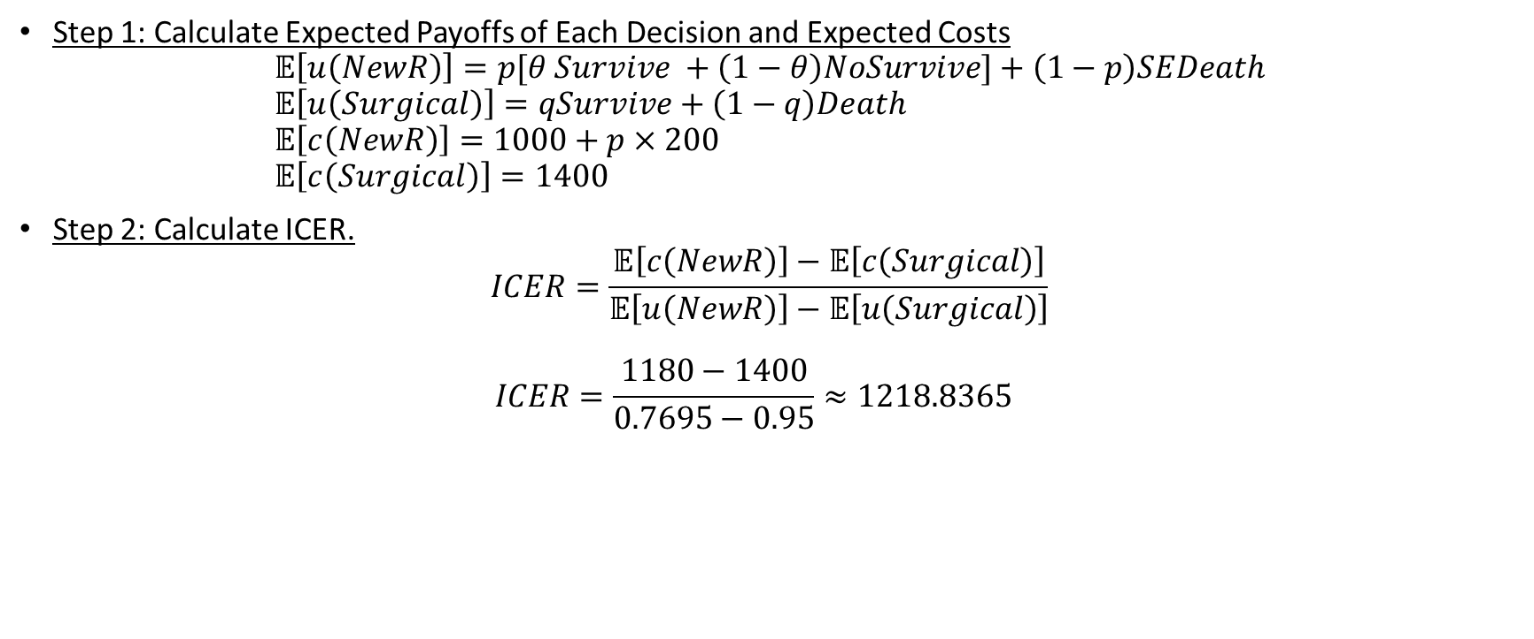
Solving the Problem
Step 1: Calculate Expected Payoffs of Each Decision and Expected Costs
$𝔼\left[u\left(NewR\right)\right]=p[θ Survive +\left(1−θ\right)NoSurvive]+\left(1−p\right)SEDeath$
$𝔼\left[u\left(Surgical\right)\right]=qSurvive+\left(1−q\right)Death$
$𝔼\left[c\left(NewR\right)\right]=1000+p×200$
$𝔼\left[c\left(Surgical\right)\right]=1400$
Step 2: Calculate ICER.
$ICER=\frac{𝔼\left[c\left(NewR\right)\right]−𝔼\left[c\left(Surgical\right)\right]}{𝔼\left[u\left(NewR\right)\right]−𝔼\left[u\left(Surgical\right)\right]}$
$ICER=\frac{1180−1400}{0.7695−0.95}≈1218.8365$

Slide 26
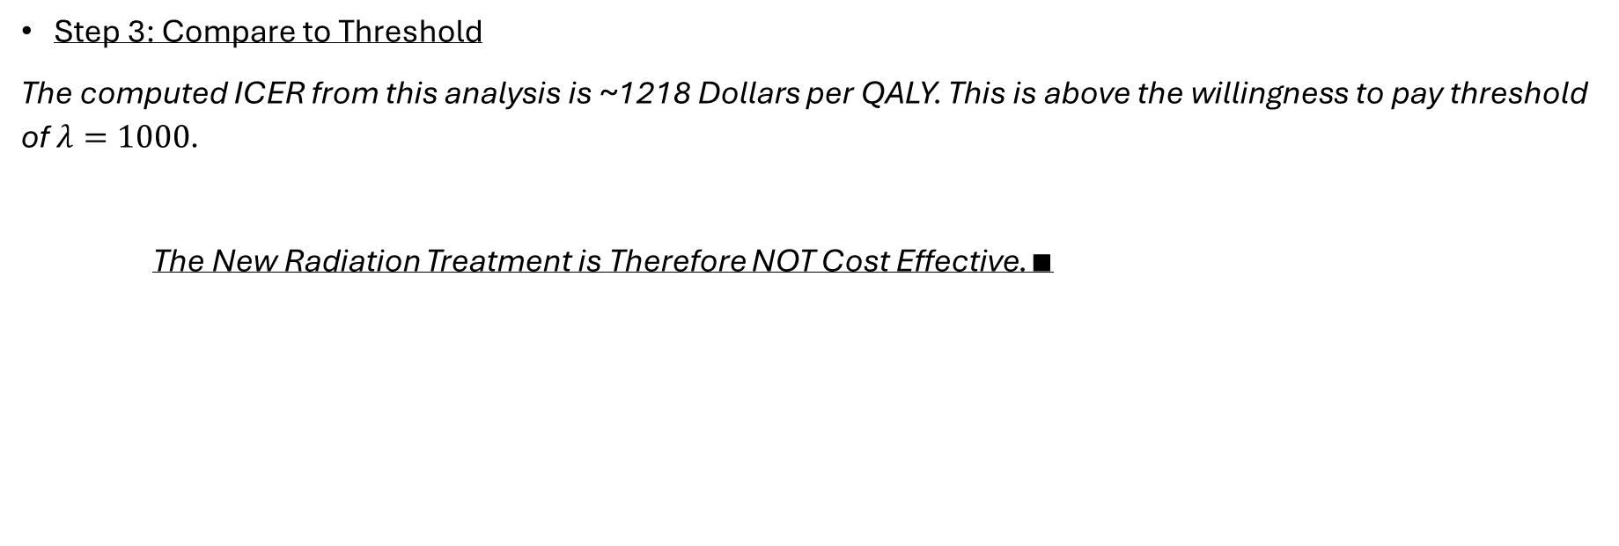
Solving the Problem
Step 3: Compare to Threshold
The computed ICER from this analysis is ~1218 Dollars per QALY. This is above the willingness to pay threshold of $λ=1000$.
The New Radiation Treatment is Therefore NOT Cost Effective.$∎$

Slide 27
Drawing Decision Trees from Expected Value Equations

Slide 28
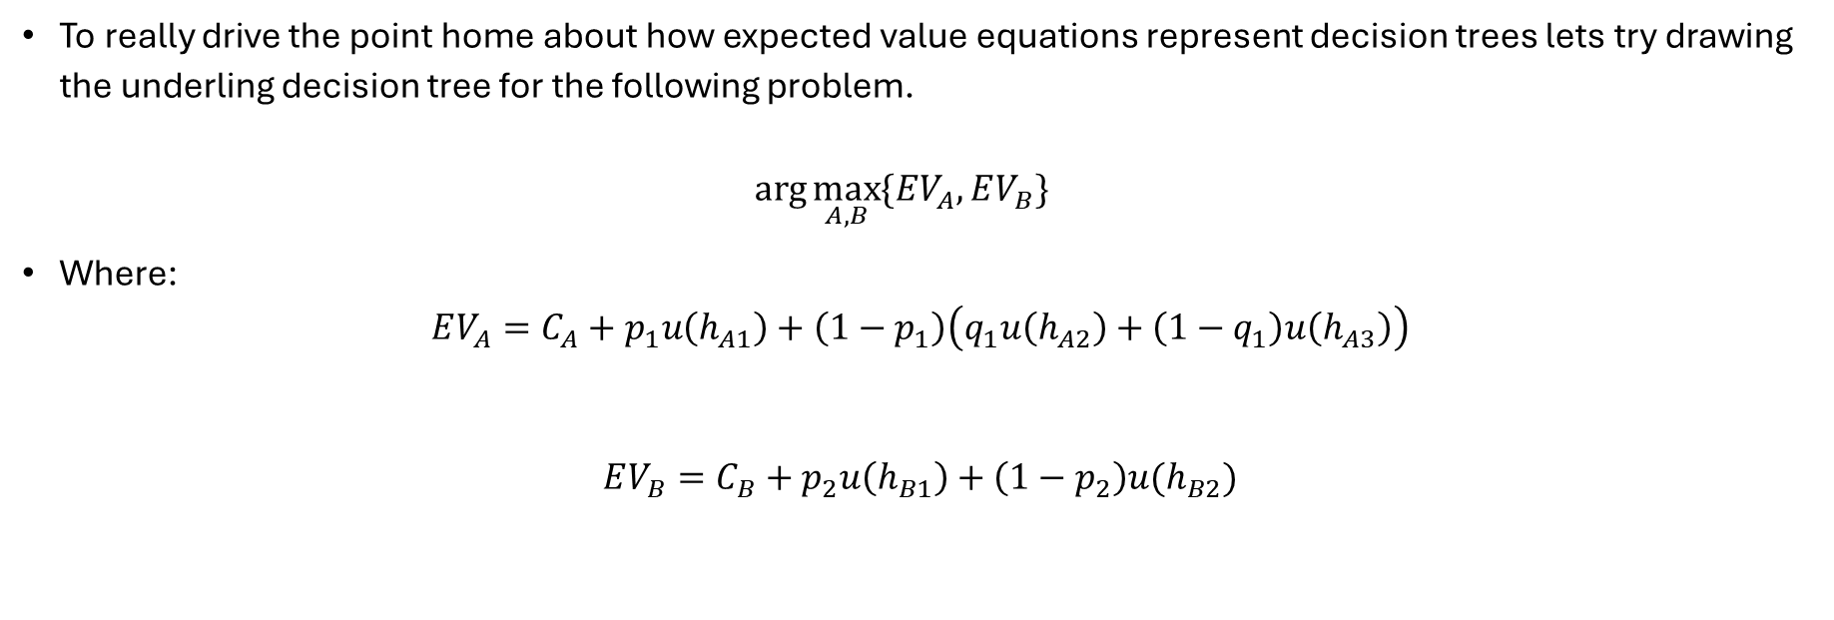
An Example of Working backwards
To really drive the point home about how expected value equations represent decision trees lets try drawing the underling decision tree for the following problem.
$\arg{\max_{A,B}{\{EV_{A},EV_{B}}\}}$
Where:
$EV_{A}=C_{A}+p_{1}u\left(h_{A1}\right)+\left(1−p_{1}\right)\left(q_{1}u\left(h_{A2}\right)+\left(1−q_{1}\right)u\left(h_{A3}\right)\right)$
$$EV_{B}=C_{B}+p_{2}u\left(h_{B1}\right)+\left(1−p_{2}\right)u(h_{B2})$$

Slide 29
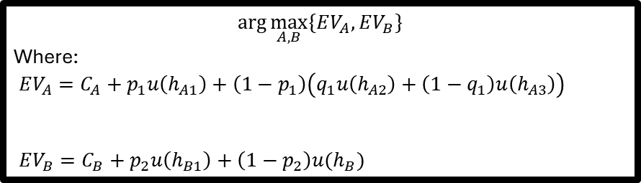
Building the tree
$$\arg{\max_{A,B}{\{EV_{A},EV_{B}}\}}$$
Where:
$EV_{A}=C_{A}+p_{1}u\left(h_{A1}\right)+\left(1−p_{1}\right)\left(q_{1}u\left(h_{A2}\right)+\left(1−q_{1}\right)u\left(h_{A3}\right)\right)$
$EV_{B}=C_{B}+p_{2}u\left(h_{B1}\right)+\left(1−p_{2}\right)u(h_{B})$

Slide 30
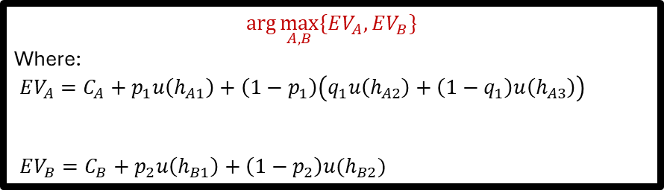
Building the tree
$$\arg{\max_{A,B}{\{EV_{A},EV_{B}}\}}$$
Where:
$EV_{A}=C_{A}+p_{1}u\left(h_{A1}\right)+\left(1−p_{1}\right)\left(q_{1}u\left(h_{A2}\right)+\left(1−q_{1}\right)u\left(h_{A3}\right)\right)$
$EV_{B}=C_{B}+p_{2}u\left(h_{B1}\right)+\left(1−p_{2}\right)u(h_{B2})$

Slide 31

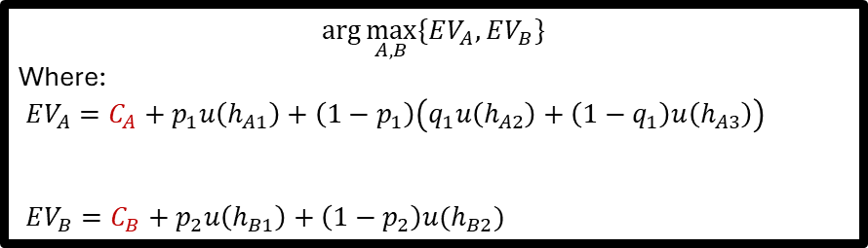

Building the tree
$$\arg{\max_{A,B}{\{EV_{A},EV_{B}}\}}$$
Where:
$EV_{A}=C_{A}+p_{1}u\left(h_{A1}\right)+\left(1−p_{1}\right)\left(q_{1}u\left(h_{A2}\right)+\left(1−q_{1}\right)u\left(h_{A3}\right)\right)$
$EV_{B}=C_{B}+p_{2}u\left(h_{B1}\right)+\left(1−p_{2}\right)u(h_{B2})$
$C_{A}$
$C_{B}$

Slide 32



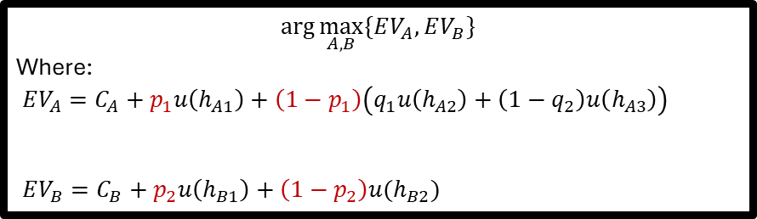



Building the tree
$$\arg{\max_{A,B}{\{EV_{A},EV_{B}}\}}$$
Where:
$EV_{A}=C_{A}+p_{1}u\left(h_{A1}\right)+\left(1−p_{1}\right)\left(q_{1}u\left(h_{A2}\right)+\left(1−q_{2}\right)u\left(h_{A3}\right)\right)$
$EV_{B}=C_{B}+p_{2}u\left(h_{B1}\right)+\left(1−p_{2}\right)u(h_{B2})$
$$p_{1}$$
$C_{A}$
$${1−p}_{1}$$
$$p_{2}$$
$C_{B}$
$${1−p}_{2}$$

Slide 33


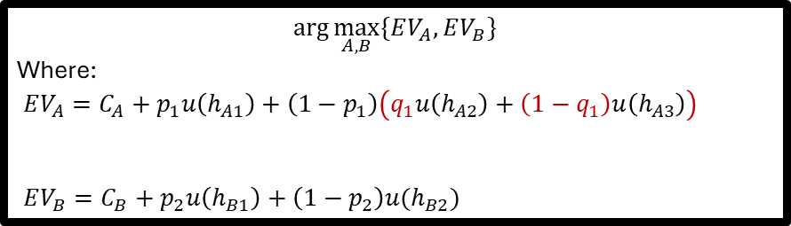




Building the tree
$$\arg{\max_{A,B}{\{EV_{A},EV_{B}}\}}$$
Where:
$EV_{A}=C_{A}+p_{1}u\left(h_{A1}\right)+\left(1−p_{1}\right)\left(q_{1}u\left(h_{A2}\right)+\left(1−q_{1}\right)u\left(h_{A3}\right)\right)$
$EV_{B}=C_{B}+p_{2}u\left(h_{B1}\right)+\left(1−p_{2}\right)u(h_{B2})$
$$p_{1}$$
$$q_{1}$$
$C_{A}$
$${1−p}_{1}$$
$${1−q}_{1}$$
$$p_{2}$$
$C_{B}$
$${1−p}_{2}$$

Slide 34


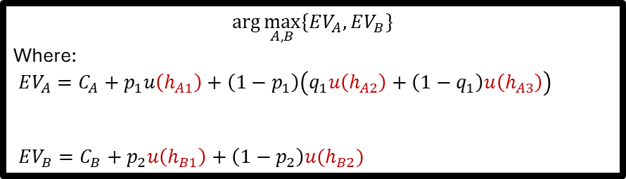





Building the tree
$$\arg{\max_{A,B}{\{EV_{A},EV_{B}}\}}$$
Where:
$EV_{A}=C_{A}+p_{1}u\left(h_{A1}\right)+\left(1−p_{1}\right)\left(q_{1}u\left(h_{A2}\right)+\left(1−q_{1}\right)u\left(h_{A3}\right)\right)$
$EV_{B}=C_{B}+p_{2}u\left(h_{B1}\right)+\left(1−p_{2}\right)u(h_{B2})$
$$p_{1}$$
$$u(h_{A1})$$
$$q_{1}$$
$$u(h_{A2})$$
$C_{A}$
$${1−p}_{1}$$
$$u(h_{A3})$$
$${1−q}_{1}$$
$$p_{2}$$
$C_{B}$
$$u(h_{B1})$$
$$u(h_{B2})$$
$${1−p}_{2}$$

Slide 35


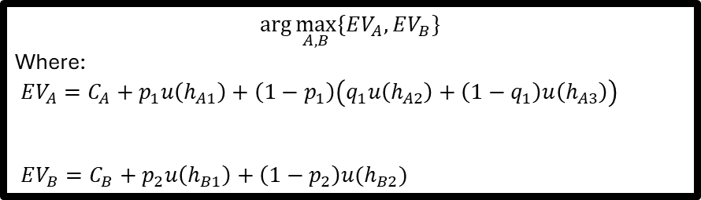



Building the tree
$$\arg{\max_{A,B}{\{EV_{A},EV_{B}}\}}$$
Where:
$EV_{A}=C_{A}+p_{1}u\left(h_{A1}\right)+\left(1−p_{1}\right)\left(q_{1}u\left(h_{A2}\right)+\left(1−q_{1}\right)u\left(h_{A3}\right)\right)$
$EV_{B}=C_{B}+p_{2}u\left(h_{B1}\right)+\left(1−p_{2}\right)u(h_{B2})$
$$p_{1}$$
$$u(h_{A1})$$
$$q_{1}$$
$$u(h_{A2})$$
$C_{A}$
$${1−p}_{1}$$
$$u(h_{A3})$$
$${1−q}_{1}$$
$$p_{2}$$
$C_{B}$
$$u(h_{B1})$$
$$u(h_{B2})$$
$${1−p}_{2}$$

Slide 36
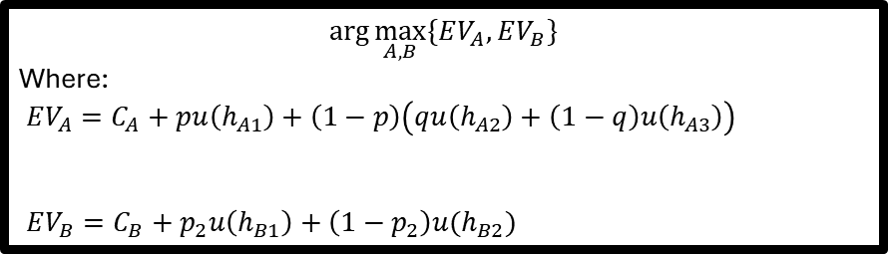
Building the tree
$$\arg{\max_{A,B}{\{EV_{A},EV_{B}}\}}$$
Where:
$EV_{A}=C_{A}+pu\left(h_{A1}\right)+\left(1−p\right)\left(qu\left(h_{A2}\right)+\left(1−q\right)u\left(h_{A3}\right)\right)$
$EV_{B}=C_{B}+p_{2}u\left(h_{B1}\right)+\left(1−p_{2}\right)u(h_{B2})$
$$p_{1}$$
$$u(h_{A1})$$
$$q_{1}$$
$$u(h_{A2})$$
$C_{A}$
$${1−p}_{1}$$
$$u(h_{A3})$$
$${1−q}_{1}$$
To compute the ICER, you need to compute the outcomes of your decision tree twice.
  Once for effects/benefits alone.
  Once for costs alone.
IF YOU CARE ABOUT THE ICER YOU NEED TO DO THIS!
$$p_{2}$$
$C_{B}$
$$u(h_{B1})$$
$$u(h_{B2})$$
$${1−p}_{2}$$

Slide 37
Last words on Decision Tree Models.
Decision Tree Models represent a choice over expected values. It is the most natural way to think about clinical decision making where outcomes are realized in the short run and events do not repeat.
They are the model which really represent the “heart” of decision analytic modelling– that is creating a model to aide in making the best decision under uncertainty.
IN OUR NEXT CLASS WE ASK:
-What if events repeat?
-What if there is a long time between events/decisions?
THIS WILL BE DISCUSSED IN DEPTH IN THE NEXT CLASS

